Slide 1
Roles, Responsibilities and Behaviour
What is an object?
What is object-orientation?
Henrik Bærbak Christensen

Slide 2
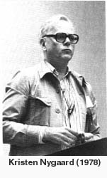
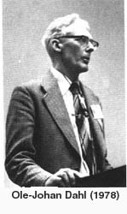
A decade of OO teaching
I was deeply rooted in Scandinavian tradition of Object-Orientation:
  Kristen Nygaard & Ole-Johan Dahl: Simula
  Ole Lehrmann Madsen et al.: BETA
“A program execution is viewed as a physical model simulating the behaviour of either a real or imaginary part of the world.”
But something was missing...
  Design patterns and frameworks are not simulating the world...
  My designs tended to cluster “Blobs” and was hard to maintain.
  How does it help me structure the GUI?
Henrik Bærbak Christensen

Slide 3
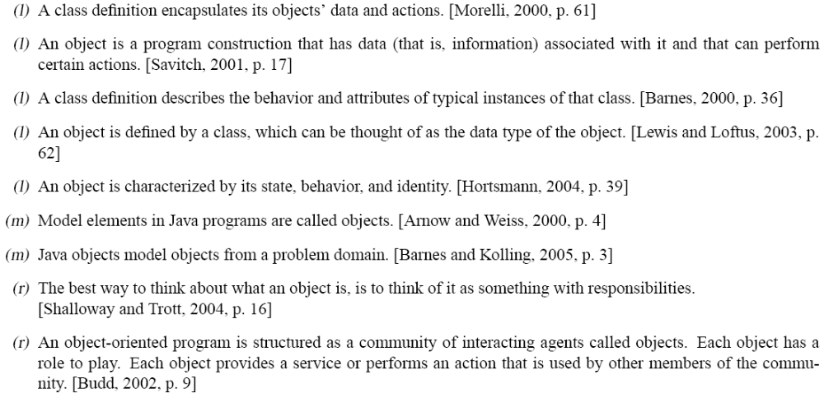
What do people say about objects?
Henrik Bærbak Christensen

Slide 4
Perspectives
Language centric perspective:
Object = Data + Actions
Model centric perspective:
Object = Model element in domain
Responsibility centric perspective:
Object = Responsible for providing service in community of interacting objects
Henrik Bærbak Christensen

Slide 5
Language-centric
Henrik Bærbak Christensen

Slide 6
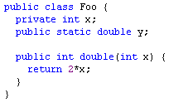
Focus
Language centric focus
  object = fields + methods
  looking at the concrete “building blocks”
  language features are emphasized
  editor view / static
Henrik Bærbak Christensen

Slide 7
Model-centric
Henrik Bærbak Christensen

Slide 8
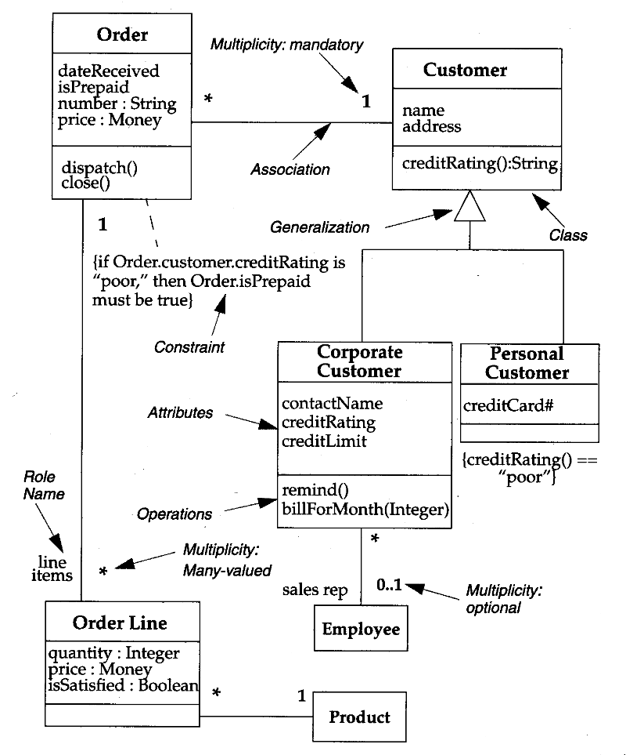

Focus
Model centric focus
  focus on concepts and relations (static!)
    generalization, association, composition
  problem domain modeling
  object = part of model
  simulation (Kay/Nygaard)
Henrik Bærbak Christensen

Slide 9
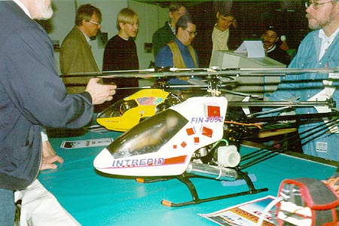
One definition of OO
Object Orientation
  A program execution is viewed as a physical model simulating the behaviour of either a real or imaginary part of the world.
  [Madsen, Møller-Pedersen, Nygaaard 1993]
Computation as simulation.
Kristen Nygaard and Ove Johan-Dahl worked
indeed in writing simulation software !
Henrik Bærbak Christensen

Slide 10
Consequences
This model-centric perspective results in
  Strong emphasis on “modelling real world”
  Strong emphasis on model elements and relations
Relation
Bass’ definition:
The software architecture of a computing system is the structures of the system, which comprise software elements, the externally visible properties of those elements, and the relationships among them.
Element
Henrik Bærbak Christensen

Slide 11
Examples
Real world
  Examples:
    My particular Dell laptop computer (phenomena)
    The concept “laptop”
IT world
  Examples:
    The PayStationImpl class (concept)
    The PayStationImpl object that ran last week (phenomena)
Phenomena
Concepts
object
class
Henrik Bærbak Christensen

Slide 12
System design as translation
translation
(modellering)
Problem specific
concepts
Realized concepts
and relations
abstraction
abstraction
Phenomena
Relations
Objects
Domain
(”real world”)
Model
(IT system)
Henrik Bærbak Christensen

Slide 13
Translation support
The strong point in OO is the language support for these aspects of human every day life.
  phenomena ➔ object
  concept ➔ class
  generalization ➔ superclass
  association ➔ object reference
  aggregation ➔ object reference (or inner class)
Henrik Bærbak Christensen

Slide 14
Simulation
The definition mentions simulation
  A program execution is viewed as a physical model simulating the behaviour of either a real or imaginary part of the world.
Simulation means “do something” ☺
  Objects have methods
  Objects interact by invoking methods on each other.
  But – where do the inspiration for methods come from?
Henrik Bærbak Christensen

Slide 15
Simulation
Most real world objects do not exhibit any interesting behaviour
  a seat in a plane does not know who reserved it
  a backgammon checker does not know how to move nor which position it has on the board
Here we usually assign extra meaning
  Animistic: attribution of conscious life to objects in and phenomena of nature or to inanimate objects
Henrik Bærbak Christensen

Slide 16
Example
The well worn example of an Account class.
Before IT an account was simply lines in a book and an understanding in the head of the banker.
An account could not add interest !
A human banker had to do that using his mathematical and business skills.
But – the IT account could be smarter ! The computerized account acts like in a Disney movie ☺
  account.addInterest();
Henrik Bærbak Christensen

Slide 17
Implications
(Language) Model perspective:
  A) Identify landscape of concepts
  B) Distribute behavior over this landscape
Guidelines:
  A) Problem domain concepts ⇨ Objects
  B) “Animate” objects / “Expert pattern”
    Keep behavior with the data
      But - an account that can add interest to itself ???
Analysis
  Problem domain concepts only fraction of full system
    database issues, architectural issues, GUI, networking, ...
  Behavior that does not belong to a domain concept?
Henrik Bærbak Christensen

Slide 18
Translation process
In other words: Who / What cycle
  Who: the objects comes first
  What: the behaviour comes second
Define the classes, next define their methods
Henrik Bærbak Christensen

Slide 19
Responsibility-centric
Henrik Bærbak Christensen

Slide 20
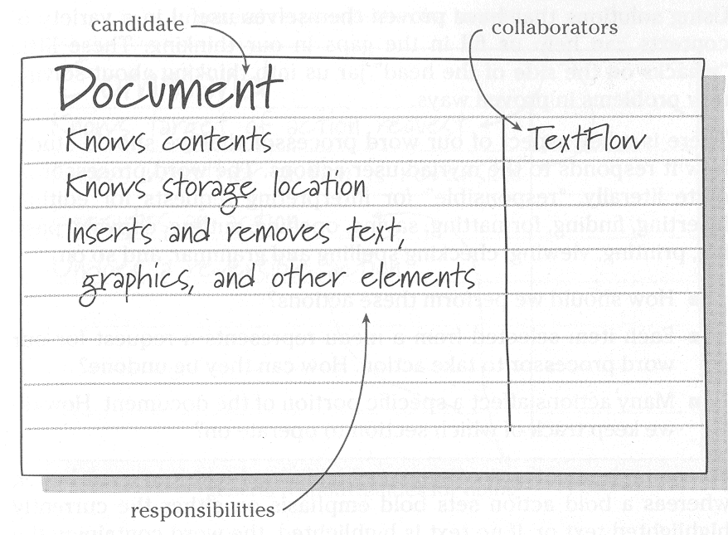
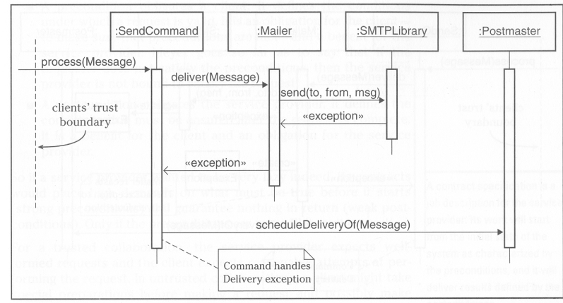
Focus
Responsibility centric focus
  Role, responsibility, and collaboration
  Object = provider of service in community
  Leads to strong behavioral focus
  CRC cards (Beck, Wirfs-Brock)
Henrik Bærbak Christensen

Slide 21
Another Definition
Another definition:
An object-oriented program is structured as a community of interacting agents called objects. Each object has a role to play. Each object provides a service or performs an action that is used by other members of the community.
  Budd 2002
Shifting focus
  away from “model of real world”
  towards “community”, “interaction”, and “service”
Henrik Bærbak Christensen

Slide 22
Service
Budd’s definition is more skewed towards the functionality of the system.
At the end of the day, software pays the bill by providing functionality that the users need, not by being a nice model of the world!
Services are what developers get paid to create!
Henrik Bærbak Christensen

Slide 23
“Success lies in how clearly we invent a software reality that satisfies our application’s requirements—and not in how closely it resembles the real world.”
[Wirfs-Brock & McKean]
Henrik Bærbak Christensen

Slide 24
We can describe ‘services’ or ‘functionality’ from different levels of abstraction:
  Behaviour: actually gets done
  Responsibility: ensure that it gets done
Henrik Bærbak Christensen

Slide 25
Behaviour
Behaviour is defined as:
Behaviour:
Acting in a particular and observable way.
In OO, it is the objects that exhibit behaviour when we invoke a method on it:
  database.executeSQL( “SELECT * FROM ...” );
  ps.addPayment(5);
Henrik Bærbak Christensen

Slide 26
However...
Behaviour (algorithms in methods) is of course the fundamental level of an executing program.
However, the concept is too low-level to be really useful in design situations.
In design, a more abstract view of behaviour is needed that shields us from the nitty-gritty details of particular algorithms...
Henrik Bærbak Christensen

Slide 27
Responsibility
Responsibility is a higher level view:
Responsibility:
The state of being accountable and
dependable to answer a request.
The difference is in doing versus accountable for doing.
Henrik Bærbak Christensen

Slide 28
Example
An example:
I am responsible for getting house garbage to a central garbage can.
Exercise:
  What kind of behaviours may be involved?
  Is there a one-to-one match between the responsibility and a particular behaviour?
  Am I interested in how exactly the garbage gets to the garbage can?
Henrik Bærbak Christensen

Slide 29
Discussion
The main point is:
  It is a responsibility to ensure the garbage gets to its right place
  I do not care what exact behaviour is used to fulfil the task.
  There may be a 100 different concrete behaviours associated with a single responsibility.
Responsibility decouple clients from the exact behaviour!
Responsibility abstracts concrete behaviour!
Henrik Bærbak Christensen

Slide 30
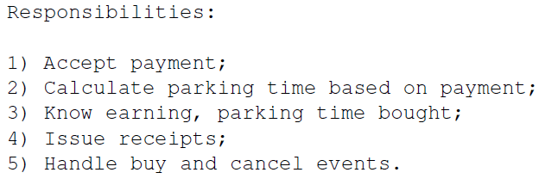
Describing responsibility
Responsibilities are best described in broad terms in the design phase:
No
  Algorithm specifications
  Programmatic details
Henrik Bærbak Christensen

Slide 31
Programming relations
Behaviour corresponds to concrete methods in Java, C#, etc.
Responsibilities are not first-class citizens in main stream languages ☹
But... The notion of an interface’s method signatures can be used to partially express responsibility...
Henrik Bærbak Christensen

Slide 32
Example
public interface PayStation {…}
The method signatures declares a set of responsibilities but does not dictate the actual behaviour (= method body). Any class implementing the interface is free to make the appropriate implementation.
Henrik Bærbak Christensen

Slide 33
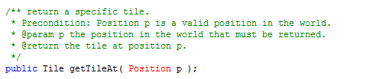
Discussion
An interface specification alone is a poor way to describe a responsibility as often there are commitments that cannot be seen only from the method definitions.
Use JavaDoc to provide more detail!
Henrik Bærbak Christensen

Slide 34
Roles
Responsibility describes a commitment to someone else...
  (I’ve got three kids, I know what I am talking about ☺)
Thus responsibility is only interesting in relation to some collaboration and mutual commitment with other objects...
We also want a more abstract (design oriented) way to express collaboration patterns and mutual obligation: Roles.
Henrik Bærbak Christensen

Slide 35
Role
Role (General):
A function or part performed especially in a particular operation or process
The role concepts
  focus both on “function” as well as “in a particular process”
  that is: both responsibilities and collaboration patterns
  decouples function from performer; maybe actor X does Hamlet better but still actor Y can do it.
Henrik Bærbak Christensen

Slide 36
Discussion
We use roles all the time!
  I would like to talk to the doctor, I am sick ☹
  Quick, call a police man
  We need to hire more programmers!
Are these specific persons?
A role defines a set of responsibilities and defines the way it collaborates with associated object (or rather ”roles”).
Henrik Bærbak Christensen

Slide 37
Protocol
The proper sequence of actions or events is important
  Hamlet must perform speech and movement in the proper sequence
  Doctor and I must interact properly
  Lecturer assume students are silent during lectures; students assume lecturer will tell something boring ☺
Protocol:
A convention detailing the expected sequence of interactions or actions expected by a set of roles.
Henrik Bærbak Christensen

Slide 38
Protocol
Warstory
  A programmer from India did not follow Danish protocol when it came to food
    Is it polite to share your candy with collegues?
    Is it polite to share your lunch with collegues?
Henrik Bærbak Christensen

Slide 39
Roles again
Role (Software):
  A set of responsibilities and associated protocol with associated roles
Henrik Bærbak Christensen

Slide 40
Roles for organising work
Roles are central for how humans organize work.
  Software shop: Roles are project leader, programmer, tester. In small companies a single person may play both project leader and programmer role; a programmer often is also tester.
  I play the role as teacher, researcher, colleague, father and husband – each with its own set of responsibilities and commitments.
  Roles are invented by need. A pre-school kindergarten invented a Flyer roles whose responsibility it was to ‘catch’ all interruptions.
Henrik Bærbak Christensen

Slide 41
Implications
Responsibility perspective:
  A) Analyze behavior (what?)
  B) Assign objects (who?)
Guidelines:
  A) Behavior abstracted ⇨ landscape of responsibilities
  B) Implement responsibilities in objects
Analysis
  Resemble human organizations – “Flyer” role
  Still need to define the objects ☺
Henrik Bærbak Christensen

Slide 42
What/Who
Timothy Budd:
“Why begin the design process with an analysis of behaviour? The simple answer is that the behaviour of a system is usually understood long before any other aspects.”
What / Who cycle
  What: identify behaviour / responsibility ⇨ roles
  Who: identify objects that may play the roles
    or even invent objects to serve roles only
      Larman “Pure fabrication”; example: Flyer role
Henrik Bærbak Christensen

Slide 43
Role concept
The role concept allows us to use either approach (who/what or what/who) because “what” can be expressed as roles.
Role makes service a first-class citizen of our design vocabulary
Relation
Role
Element
Henrik Bærbak Christensen

Slide 44
Roles versus objects
The role – object relation is many-to-many.
One Role - many Objects
  Interface Comparable in Java
    Allow any object to be sorted by Collections.sort
One Object – many Roles
  Henrik implements Teacher, Researcher, Writer, Student, Father, Husband, Company-Owner, Tax-payer, Citizen, Danish, ...
    but not at the same time...
Henrik Bærbak Christensen

Slide 45
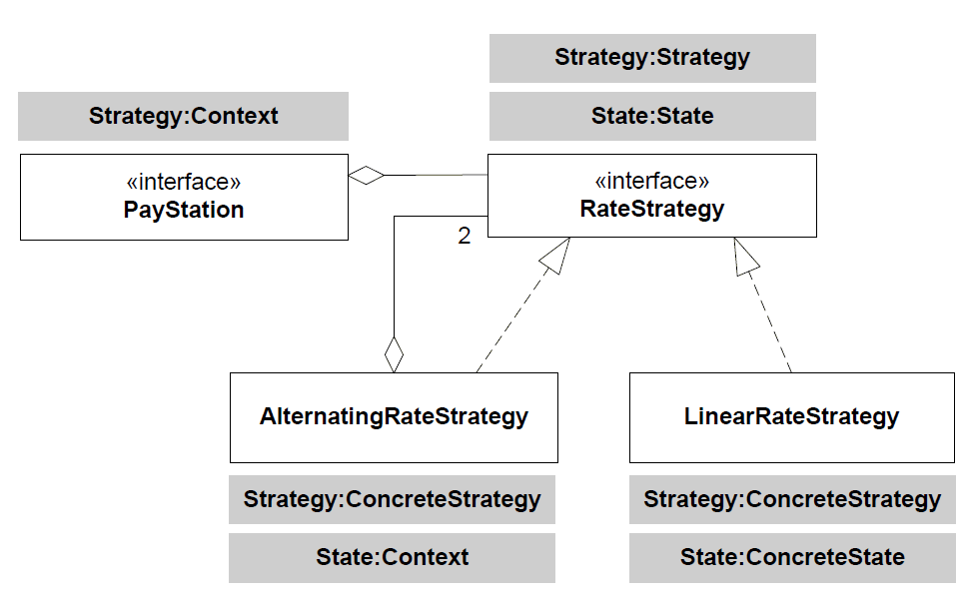
Roles & Patterns
Henrik Bærbak Christensen

Slide 46
Role – Object
Why difference does it make?
Henrik Bærbak Christensen

Slide 47
Where is the difference?
What is the point?
  I associate responsibilities with roles?
  I associate responsibilities with concepts (classes)?
At first sight there seems to be none...
Shalloway and Trott has a nice example of the difference...
Henrik Bærbak Christensen

Slide 48
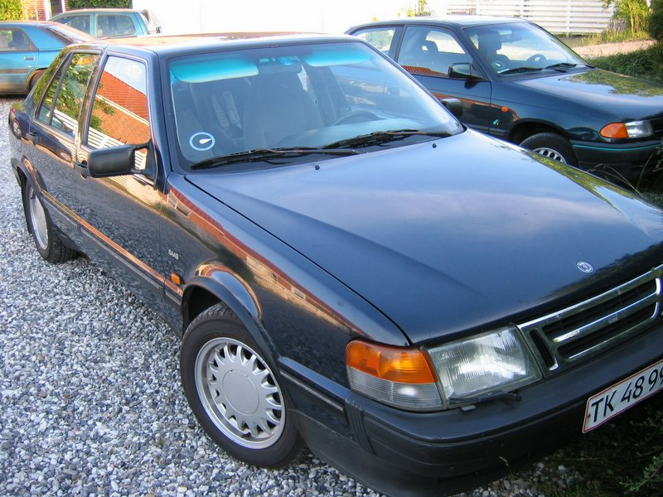
The difference
Umbrella concept
  metal rod aggregate spikes associated with linen
Umbrella role
  keeps me dry when it is raining
?
Henrik Bærbak Christensen

Slide 49
Umbrella again...
class Car extends Umbrella ?
class Umbrella extends Car ?
class Car implements Umbrella
NONSENSE!
More sensible
Henrik Bærbak Christensen

Slide 50
Another Example
Henrik Bærbak Christensen

Slide 51
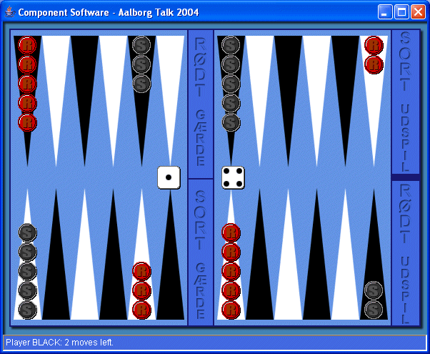
A Case Study
Backgammon requirements:
  Offer GUI for two players
  Guaranty proper play
Variants
  new rules for which moves are legal
  how many moves you can make per turn
  how the board is initially set up
Henrik Bærbak Christensen

Slide 52
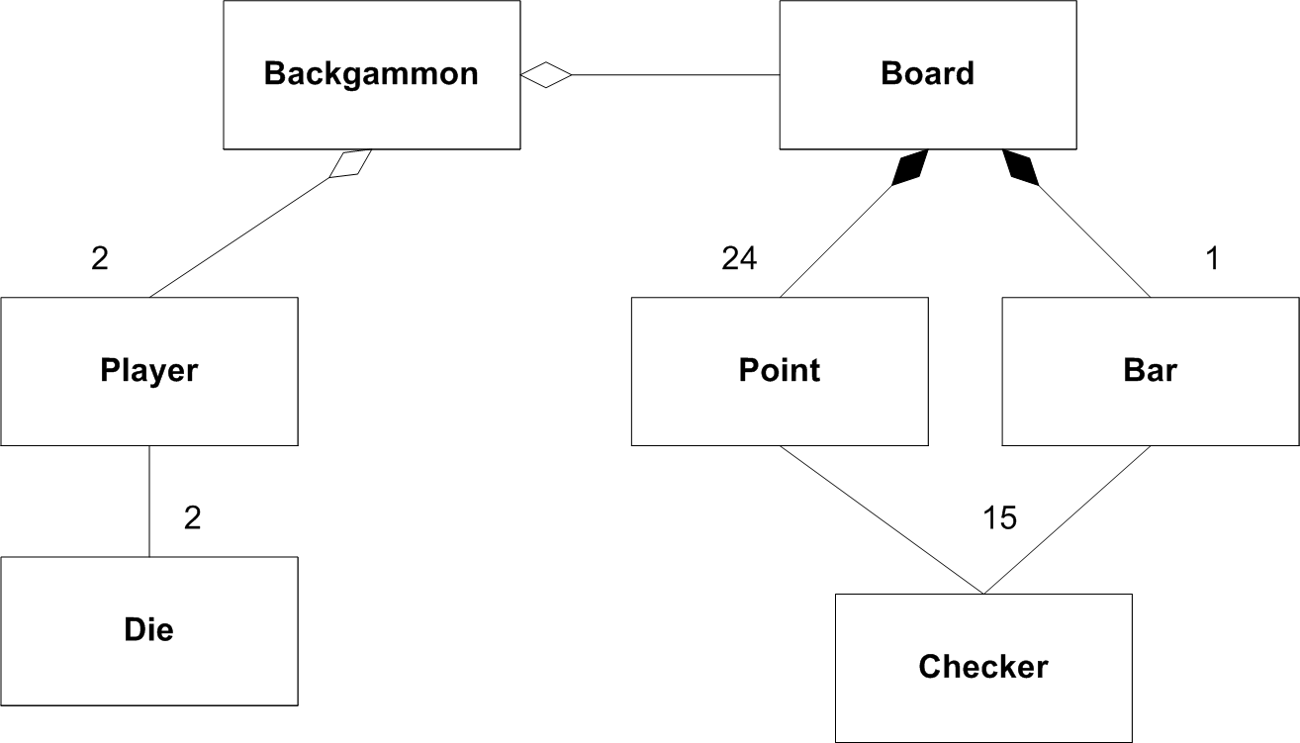
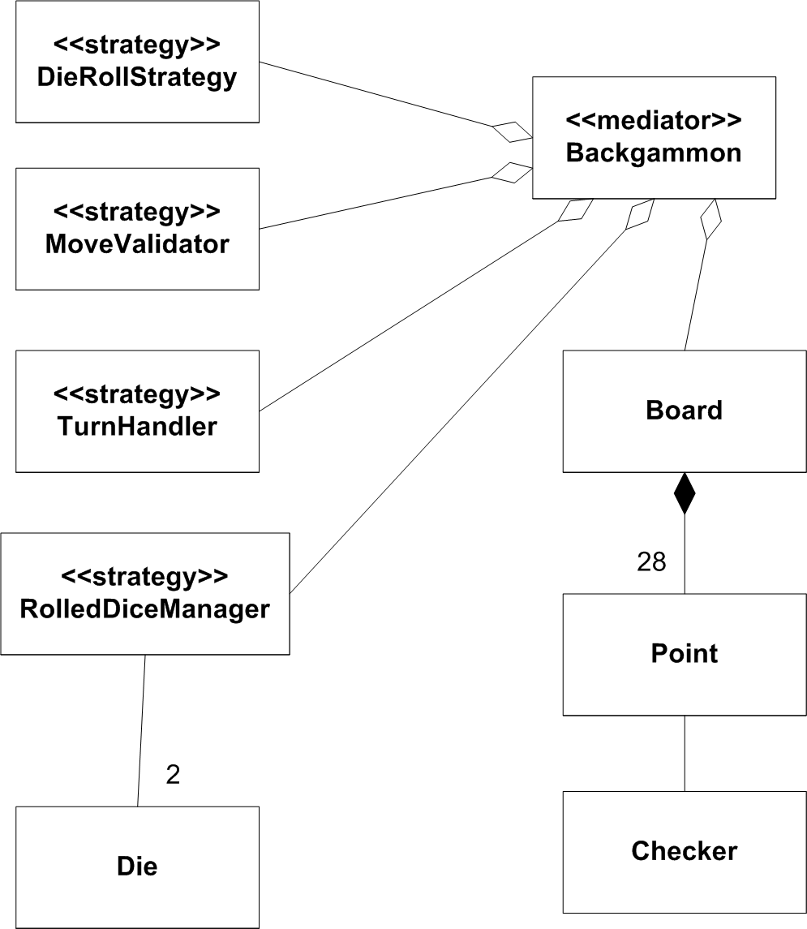
Same challenge – different designs
Model perspective:
Responsibility perspective:
Objects from domain
Objects providing services
Henrik Bærbak Christensen

Slide 53
Who is responsible for validating moves?
Model perspective:
Responsibility perspective:
What is the cost of altering validation strategy?
How to change it at run-time?
Henrik Bærbak Christensen

Slide 54
Summary
Henrik Bærbak Christensen

Slide 55
Summary
Behaviour:
  The basic, concrete, functionality provided by an object
Responsibility:
  Design level concept of accountability on answering a request
Role:
  Design level concept to express a well defined set of responsibilities and collaboration pattern
Henrik Bærbak Christensen

Slide 56
Perspectives
Three different perspectives on OO
  Language: Important because code is basically only understandable in this perspective
  Model: Important because it gives us good inspiration for organizing the domain code
  Responsibility: Important because it allows us to build highly flexible software with low coupling and high cohesion
They do not have to be in conflict –they build upon each other...
Henrik Bærbak Christensen

Slide 57
Summary
Design in terms of what roles and responsibilities there are in a system.
Express these as interfaces with appropriate additional documentation.
Implement the roles by concrete classes.
Roles may define points of variability in programs…
Henrik Bærbak Christensen

